Slide 1
The Professional Educator Standards Board
Slides available at: http://bit.ly/2GF56OH
April 25, 2019
Alexandra Manuel, Executive Director
Maren Johnson, Preparation and Credentialing Policy Lead
Jisu Ryu, Program Manager, Educator Assessment & Data Analysis

Slide 2
Who we are:
The Professional Educator Standards Board (PESB)
Created in 2000, PESB ensures that Washington’s educator workforce is composed of highly effective, professional educators who meet the diverse needs of schools and districts. PESB works towards this vision by creating innovative policies that improve and support educator quality, workforce development, and diversity. RCW 28A.410.210
The Paraeducator Board
Created in 2017, the Paraeducator Board establishes requirements and policies for paraeducator professional development certificates, and makes policy recommendations that will increase opportunities for paraeducator advancement through education, professional learning, and increased instructional responsibility. RCW 28A.413.020
Notes:
The Professional Educator Standards Board (PESB)
PESB consists of twelve members appointed by the Governor, the majority of whom are practicing educators.
Created in 2000, PESB ensures that Washington’s educator workforce is composed of highly effective, professional educators who meet the diverse needs of schools and districts.
PESB works towards this vision by creating innovative policies that improve and support educator quality, workforce development, and diversity.
The Paraeducator Board
The Paraeducator Board consists of nine members, representing a variety of education sectors including paraeducators, teachers, administrators, superintendents, college professors, principals, and from other various education roles.
Created in 2017, the Paraeducator Board:
Establishes requirements and policies for paraeducator professional development certificates
Makes policy recommendations that will increase opportunities for paraeducator advancement through education, professional learning, and increased instructional responsibility

Slide 3
What we believe in
We believe in high standards.
  High standards for all educators are essential to student success and achievement. To support our students, we must support our educators.
We believe in a diverse workforce.
  Diverse students and educators are a tremendous asset to our state and workforce. We are committed to lifting up those assets and addressing inequities, disparities, and barriers within the overall educator preparation system.
Notes:
A collaborative approach
PESB and the Paraeducator Board recognize that high standards for all educators are essential to student success and achievement.
To support our students, we must support our current and future educators.

Slide 4
What we do
Our work stretches across the educator continuum:
Recruitment
Preparation programs
Retention
Workforce development
Examining barriers into the profession
Ensuring access into the profession with Grow Your Own programs
Initiatives that work to close the teacher-student diversity gap.
Program approval and review
Programs are developing educators to be culturally responsive
Supporting district HR offices with training on recruitment and retention
Responsive to the educator shortage
Certificate renewal
Professional Growth Plans
Clock hours and continuing education
Second tier licensure

Slide 5
what we do
Professional Educator Standards Board
Educator quality
Overseeing licensure and continuing education policy for all educator roles in the state
Approval and review of educator preparation programs
Creating and supporting continuing education opportunities for educators
Workforce development and diversity
Diversifying and expanding the educator workforce
Responding to district workforce needs
Building a culturally responsive educator workforce
Policy innovation
Investigating barriers, inequities and disparities within the education system
Using an equity lens in all that we do
Notes:
Educator quality
Overseeing licensure and continuing education policy for all educator roles in the state.
Ensuring preparation programs create qualified professional educators by overseeing approval and review for all programs across the state.
Encouraging educators to participate in professional learning opportunities, including continuing education for certificate renewal, clock hours, professional growth plans, and optional second tier licensure.
Establishing minimum employment requirements for all Washington paraeducators.
Supporting paraeducators by designing and implementing professional standards of practice, a professional development certificate program, and pathways to become a teacher.
Workforce development and diversity
Diversifying and expanding the educator workforce by ensuring access to the profession, supporting and overseeing programs and initiatives like Grow Your Own, Recruiting Washington Teachers, and Alternative Routes to Certification.
Responding to district workforce needs, including addressing shortage areas and supporting Human Resource (HR) offices in educator retention and recruitment.
Building a workforce that is culturally responsive. Cultural competency standards guide the development of cultural responsiveness in Washington’s educators. Competencies in civil rights, anti-bias, and teaching effectiveness in culturally diverse populations are included at each stage of the educator continuum.
Policy innovation
Investigating barriers, inequities and disparities within the education system and offering recommendations for solutions based on research and stakeholder engagement.
Prioritizing an equity lens in all that we do by identifying innovative opportunities to improve policy on access, preparation effectiveness, continuing education, educator quality and educator diversity.

Slide 6
what we do
Paraeducator Board
Educator quality
Establishing paraeducator minimum employment requirements
Ensuring all paraeducators adhere to the same standards through training, no matter the school or region they work
Workforce development and diversity
Supporting paraeducators with professional development opportunities through the certificate program
Policy innovation
Make policy and budget recommendations for a paraeducator career ladder that will increase opportunities for professional advancement
Notes:
Educator quality
Establishing paraeducator minimum employment requirements
Ensuring all paraeducators receive the same training, no matter the school or region they work in
Workforce development and diversity
Supporting paraeducators with professional development opportunities through the certificate program
Policy innovation
Make policy recommendations for a paraeducator career ladder that will increase opportunities for professional advancement

Slide 7
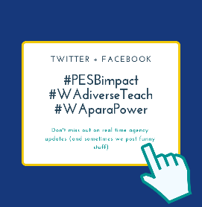



Communications
Social media
Website
Newsletters
Notes:
We offer and encourage a variety of ways to engage with us as an agency, and with the work we oversee.
Follow us on social media and join the conversation with #PESBimpact, #WAparaPower, and #WAdiverseTeach
Subscribe to our newsletters - It only takes a few seconds to subscribe to a lifetime of the best emails you'll ever read!
Visit our website and become familiar with a variety of materials we offer

Slide 8
Positions open at PESB
Program Manager for Professional Learning, Assignment, and Program Support
Program Manager for Pathways and Grow Your Own
and upcoming….
Program Specialist, Paraeducator Certificate Program

Slide 9
Progress and upcoming work groups
Standards Approval and Review
PEABs
Advancing Equity
CTE
Educator Pathways Council
Mentoring work group

Slide 10
Recent news and updates
Washington school districts can now submit grant applications to pilot a bilingual high school teacher academy.
  RWT-BEI program pilot sites use the RWT curriculum, which emphasizes the importance of cultural identity and equity in the profession of teaching. Learn more on our website.
Last change to access ProTeach report
  The ProTeach Portfolio is an evidence-based assessment designed for teachers seeking the WA professional certificate. Candidates who have not downloaded a copy of their WA ProTeach report will have until April 30 to do so. After this time reports will no longer be available.

Slide 11

A cause for celebration: eliminating testing barriers and improving access
Today, Governor Inslee is signing HB 1621, a bill to help admit more candidates into the teaching profession by removing the requirement of meeting a specific score on the WEST-B exam.
Notes:
The demographic gap between the cultural and linguistic background of our state's students and their teachers has persisted despite concerted efforts to recruit and retain teacher candidates of color and bilingual teachers. Nearly 50% of our students identify as students of color, while only 11% of their teachers identify as teachers of color. In 2018, PESB convened a testing barriers work group to investigate testing barriers experienced by candidates of color and bilingual candidates, and develop recommendations for consideration by Washington State Legislature.
As a result of the workgroup, we are extremely proud to share that today, Governor Inslee is signing HB 1621, a bill to help admit more candidates into the teaching profession by removing the requirement of meeting a specific score on the WEST-B exam.
This legislative session proved our state is committed to addressing disparities in teacher testing requirements. Washington cannot afford to lose potential educators who bring a range of diverse strengths and skills to the classroom, but are unable to enter a preparation program because passing the basic skills test became an inequitable barrier.

Slide 12
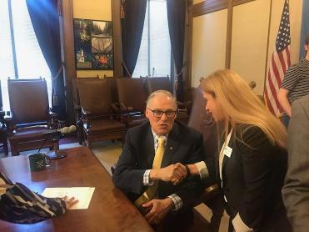
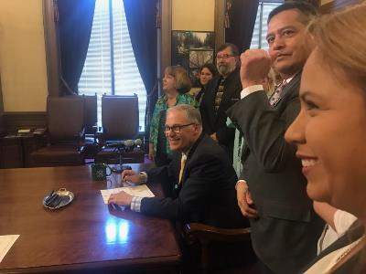
Pictures from the signing

Slide 13
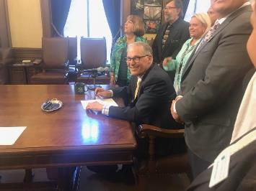
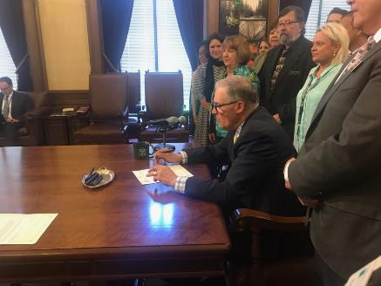

Slide 14
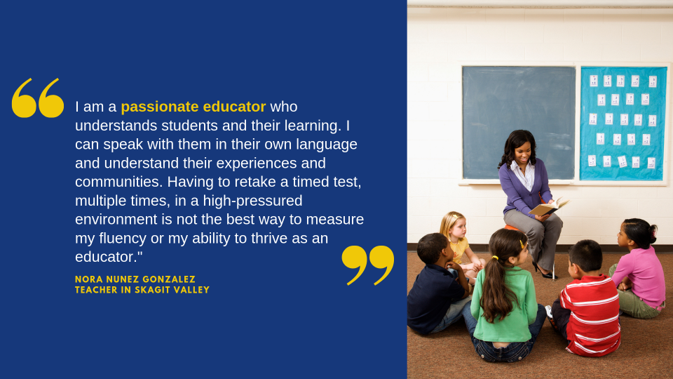
Notes:
Nora’s story and experience is not unique. Passionate educators like her experience the same testing barriers, preventing them from earning their teaching certificate. The basic skills assessment will now be used as one of multiple measures that gauge a candidate’s skills upon entry, allowing for other more equitable variables to be considered. Additionally, the passing of HB 1621 not only improves access into the profession, but also addresses the educator shortage, and supports building a more diverse educator workforce.
Further information around timeline and implementation will be released in the coming days and weeks. We encourage you to reach out with questions as this will impact every prep program and all future program candidates.

Slide 15
So what does this new legislation mean?
HB 1621/SB5512 :
An applicant must take this basic skills assessment, or an alternative or equivalent basic skills assessment as determined by the Washington professional educator standards board, and report the individual results to the Washington professional educator standards board and an approved teacher preparation program…..
Status: Signing date April 24, 2019

Slide 16
Basic skills assessment update
  Meeting a state-wide passing score on WEST-B/ACT/SAT is no longer required for program admission, student teaching, or certification.
  Programs may now admit candidates under this policy. Programs may now recommend candidates, and candidates may apply now for certification.
  Candidates still must take the basic skills assessment.
  No one needs to retake the basic skills assessment.
  Out-of-State (OOS) candidates who are applying for residency certification and applying to master’s level program may use the OOS equivalent tests approved by PESB.

Slide 17
Basic skills as formative assessment
From HB 1621: Programs may use results from the basic skills formative assessment of academic strengths and weakness in determining the candidate's readiness for the program

Slide 18
FAQ in Progress
Here is the link to our FAQ on basic skills policy! http://bit.ly/2XG4U7C
What questions do you have?

Slide 19
Board Decisions: National Standards
Approved the adoption of national standards* | Business and Marketing Early Childhood Education
Postponed the consideration of national standards adoption | Special education Library media Family and Consumer Sciences
Directed further research | Reading
* National standards implementation timeline

Slide 20
School psychologist preparation
Board decided to continue exploration of respecialization options for clinical psychologists to become school psychologists
NASP is currently revising their school psychologist standards to include respecialization standards. Provide input to NASP through May 10: http://bit.ly/2UvzA9M
NASP is anticipating adopting the new standards in June 2020, and our board might examine respecialization options at that point.

Slide 21
Residency and initial ESA certificates
School counselors and school psychologists complete residency certificate programs, aligned to board-adopted standards, approved and reviewed by PESB
Candidates for initial certificates meet certification requirements. Programs are not approved or reviewed by PESB.
Initial certificates: school occupational therapist, school physical therapist, school social worker, school nurse, and school speech language pathologist or audiologist

Slide 22
ESA Certification Work Group
Renewal of initial and continuing ESA certificates in five year intervals with 100 clock hours or the equivalent in credits or PGPs. Beginning September 1, 2020.
Professional Transitions to Public Schools course to be a fifteen hour requirement instead of a thirty hour requirement
Addition of a Behavior Analyst initial ESA certificate

Slide 23
Requirements for the behavior analyst initial certificate
Valid Board Certified Behavior Analyst (BCBA) certificate from the Behavior Analyst Certification Board (BACB), or other national certificate as approved by PESB.
Master’s degree or higher in any area.
Passing score on the Board Certified Behavior Analyst (BCBA) exam from the Behavior Analyst Certification Board (BACB), or other assessment as approved by PESB.
Complete the professional transitions to public schools coursework per WAC 181-79a-224 (currently in WAC 181-79a-223.)

Slide 24
Recommendations from the clock hour work group

Slide 25
Clock hours are a unit of currency for
continuing education in Washington state.
Clock hours serve in two main ways:
Clock hours may be used for certification. WAC 181-85
Clock hours may be eligible for salary advancement.
(Clock hours for salary advancement are not part of PESB policy.)

Slide 26
Flexibility and access for educators:
Work group recommended accepting:
Department of Children, Youth, and Families (DCYF) STARS hours as clock hours
Allowing all educators, not just ESAs, to use hours which satisfy Department of Health (DOH) licensure requirements as clock hours
Continuing education units (CEUs) or other non-credit bearing units from accredited colleges or universities, whether in-state or out-of-state, as clock hours. Credits from these same institutions are already accepted.

Slide 27
All clock hour providers must meet standards
When partnering with another organization, an approved clock hour provider cannot provide blanket approval of all courses from that organization. The clock hour provider must follow all relevant policy for approving each individual course. 181-85-200
Clock hour provider approval happening right now: http://www.k12.wa.us/certification/clockhours.aspx Deadline: August 20, 2019

Slide 28
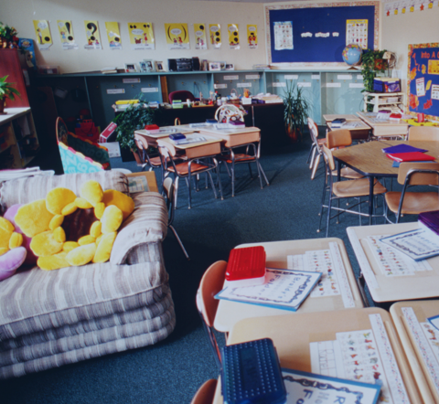
New educator shortage report from PESB
Available online at bit.ly/PESBshortage

Slide 29
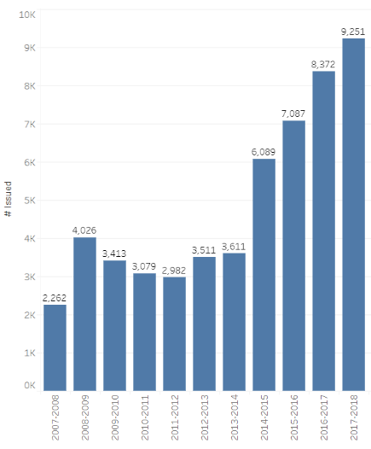
Number of limited certificates issued per year for the last 11 years
The number of limited certificates issued has tripled in the past six years.
Source: eCertification. Includes limited certificates of all types.
Notes:
https://public.tableau.com/profile/cameron.smith2099#!/vizhome/45-limitedcertsissedinthelast10years2018_08_29/Story1
Caveats:Data as of Oct 8, 2018. Data does not take into account employment of certiﬁcate holders. Certiﬁcate years are deﬁned as July 1 to June 30.
Source: OSPI eCert
Contact: PESB@k12.wa.us

Slide 30
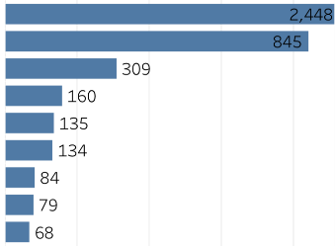
Areas on limited certificates issued in 2017-18
Area
Career Technical Education (CTE)
Elementary Education
Special Education
Mathematics
Science
English Language Learner
Speech Lang Pathologist or Audiologist
English Language Arts
Spanish
School Nurse
Health/Fitness
School Psychologist
School Counselor
65
57
33
29
Federal shortage report
Graph not to scale.
Source: eCert.
Notes:
All conditional certificates require 50 clock hours or the credit equivalent completed subsequent to the issuance, but prior to the reissuance, of the certificate. These clock hours or the credit equivalent may be completed in a program.
(This is a new requirement for the CTE conditional certificate. Prior to this year, there was no professional development requirement for the CTE conditional certificate. The clock hours or credit equivalent for the CTE conditional certificate must be aligned to CTE competencies.)
All conditional certificates require that the district develop a plan of support or a written training plan for the individual.
When requesting a conditional CTE certificate, the district must verify that no person with CTE certification in the field is available--this indicates a shortage.

Slide 31
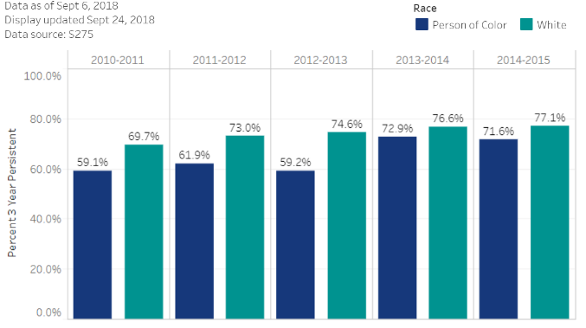
Three year persistence of new educators of color and new white educators
What percentage of educators are employed three years later?
Source: S275
Notes:
https://public.tableau.com/profile/cameron.smith2099#!/vizhome/PersistenceofnewWhiteandPoCeducators18_09_24/Chart
Methodology: A count of educators appearing each in the S275 as a new educator under Cbrtn code 'B' and in duty code 11, 12, 13, 21, 22, 23, 24, 31, 32, 33, 34, 41, 42, 43, 45, 46, 47, 48, 49 , 51, or 52 was taken. This was the count of new educators. This list of new educators was then compared against the next year's S275 and the one following that. Educators who appeared in those two S275 under Cbrtn codes 'C' or 'T' and in one of the listed duty codes were considered 3 year persistent. Educators were coded as a Person of Color if they were reported as being ethnically Hispanic (regardless of further reported race), or if their race was Asian, Black, Native American, Pacific Islander, or mixed. Those with their race recorded only as White were coded as White. Those with no recorded race were coded as Missing. Caveats: Data as of Sept 6, 2018. Data does not account for part time or full time employment, assignment, or changing racial codes. Some educators will be double counted or dropped from the persistent count if their reported race changes significantly. Source: S275 Contact: PESB@k12.wa.us

Slide 32
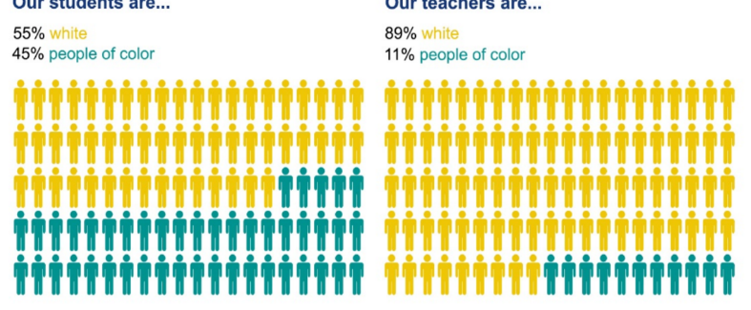
The challenge
45% of our students identify as students of color, while only 11% of teachers identify as educators of color (Source: S275).
Notes:
Research shows that increasing a student’s ability to make ethnic and cultural connections with their educators can support student achievement and have a long-term impact on a student's likelihood of graduating on time.

Slide 33
Using an equity lens
PESB has prioritized investing in and creating a range of initiatives to close the teacher-student diversity gap. These efforts include:
creating more accessible, community-orientated educator pathways
expanding access points into the teaching profession
critically examining barriers that candidates may face on their journey to becoming a teacher
Notes:
PESB has prioritized investing in and creating a range of initiatives to close this diversity gap. These efforts include creating more accessible, community-orientated pathways and expanding access points into the teaching profession, as well as critically examining barriers caused by systemic racism that candidates may face on their journey to becoming a teacher.

Slide 34
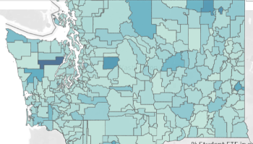
Explore district level local
workforce data at PESB
Interactive displays of local data available on our PESB website: https://www.pesb.wa.gov/district-info
District level data on:
  Use of limited certificates
  Educator persistence
  Out-of-endorsement
  assignment
  Employment demographics

Slide 35
What information regarding educator shortage are you interested in?

Slide 36

www.pesb.wa.gov
Notes:
Closing remarks

